Slide 1
Project Bootcamp Program

Slide 2
Timelines
Date | Time | Task Description
02-10-2022 | 9 AM – 10 AM | Project Kick-off Meeting
09-10-2022 | 9 AM – 10 AM | Understand the Dataset and KPI’s
16-10-2022 | 9 AM – 10 AM | Implementation of KPI’s using Excel
23-10-2022 | 9 AM – 10 AM | Implementation of KPI’s using Tableau - Part I
30-10-2022 | 9 AM – 10 AM | Implementation of KPI’s using Power BI – Part II
06-10-2022 | 9 AM – 10 AM | Final Presentation of the Project

Slide 3
Dataset
Domain : Insurance
Dataset Name: Dialysis – I & Dialysis – II
Dataset Type: Xlsx Data
Dataset Size: Each CSV file has 7k+ records
Tool Use-Tableau Or Power BI

Slide 4
KPI’s
Branch Dashboard
Branch dashboard to discuss New and renewal business number with each branch. This dashboard will be discussed between Corporate team and Individual branch heads.
Individual performance within the branch:
Target FY from Individual target sheet (New, Cross sell and Renewal) Fields to be referred (Column C, E, F and G)
Placed Achievement form Brokerage + Fees sheet (New, Cross sell and Renewal) (Brokerage sheet: Column G, J, M, K, L) (Fees Sheet: B, D, E, F, G)
Invoiced Achievement from Invoice sheet (New, Cross sell and Renewal) Column (B, F, G, J)
Percentage of Achievement for Placed and Invoice – (Achieved/budget)
No of meetings for current year – Meeting sheet (A, C, D)
Open Oppty – Opportunity report (Column: C, E, F, G) (Stage ‘Open’ Column G = Propose Solution & Qualify Opportunity)
Closed Won – Opportunity report (Column: C, E, F, G) (Stage ‘Won’ Column G = Won)
Conversion Ratio (Closed Won/Total Opportunity)
Further drill down to individual level top 10 open oppty and Win
KPI List
1-No of Invoice by Accnt Exec
2-Yearly Meeting Count
3.1Cross Sell--Target,Achive,new
3.1New-Target,Achive,new
3.1Renewal-Target, Achive,new
4. Stage Funnel by Revenue
5. No of meeting By Account Exe
6-Top Open Opportunity

Slide 5
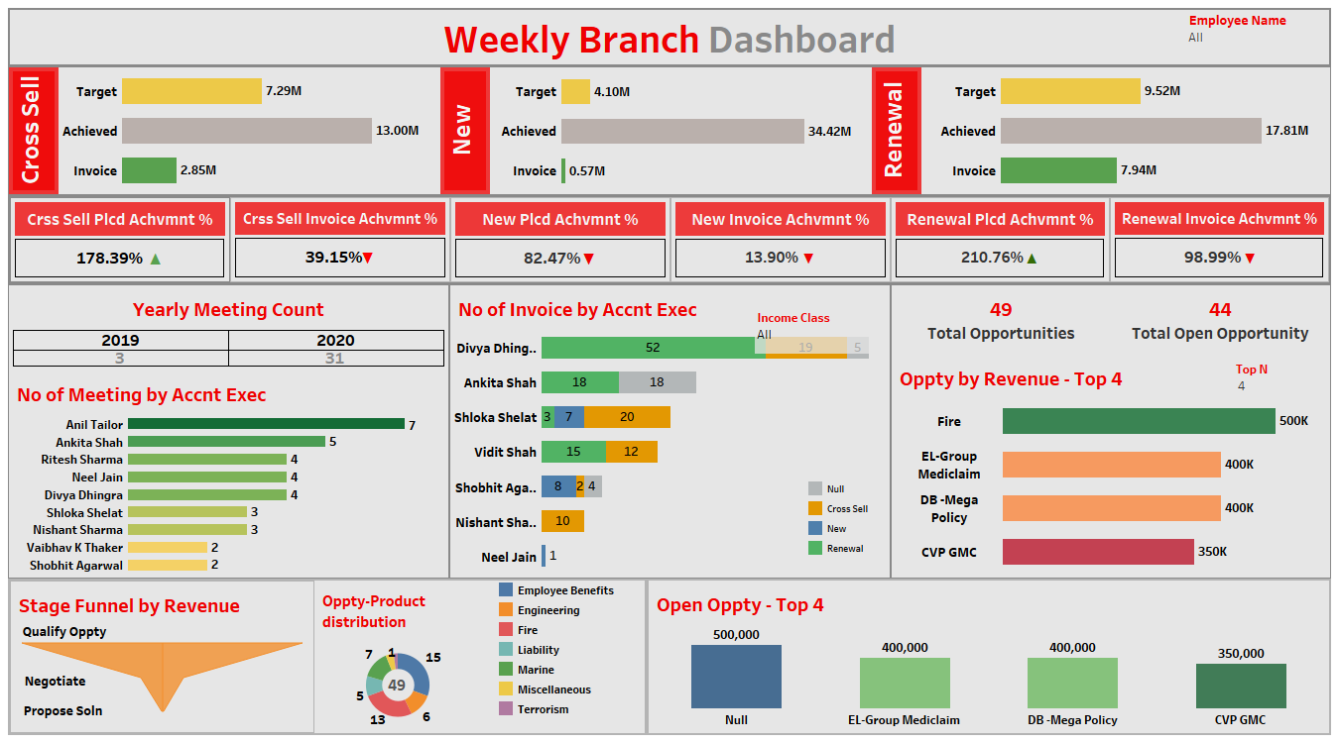
Dashboard

